Slide 1
Another way to do things with Node

Slide 2
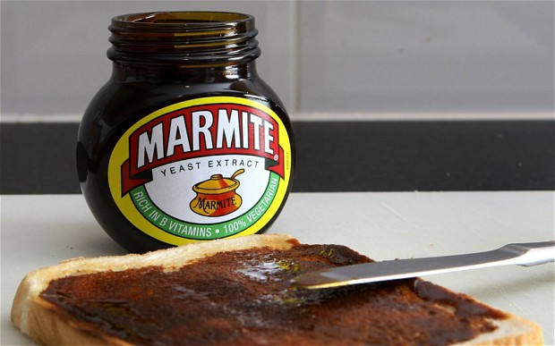
Marmite

Slide 3
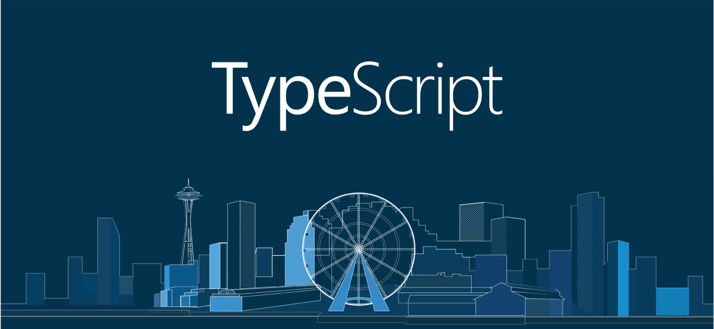
Typescript

Slide 4
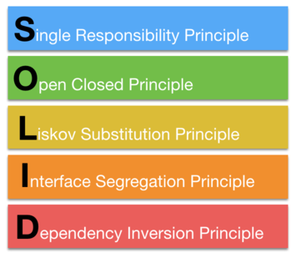
SOLID

Slide 5
RAM-T
Reliability
Availability
Mantainability
Testability

Slide 6
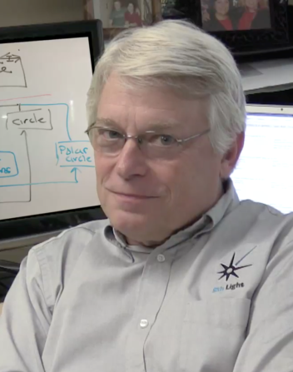

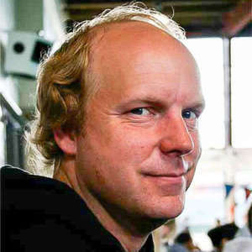
Agile loves SOLID
Martin Fowler
Kent Beck
Robert Cecil Martin

Slide 7

TC39 Loves Typescript
Do you like arrow functions, Class, async/await..? All came from Typescript.
Some of you now in person one of the 3 main members of TC39, who is also the one pushing more on OOP/Typescript features: Daniel Ehrenberg
https://github.com/tc39/proposals

Slide 8


And is not the only one loving Typescript…

Slide 9
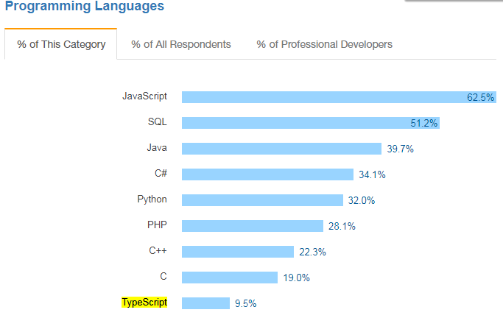
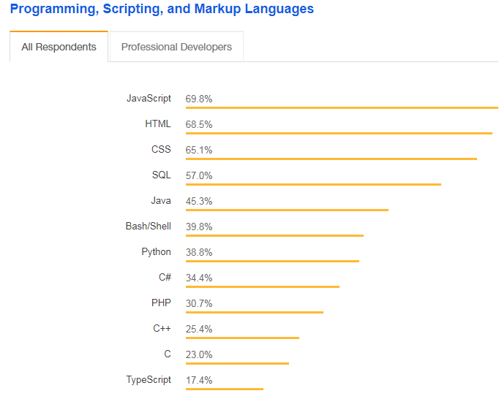
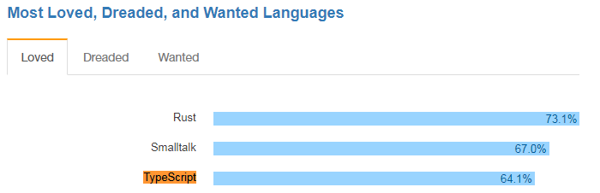
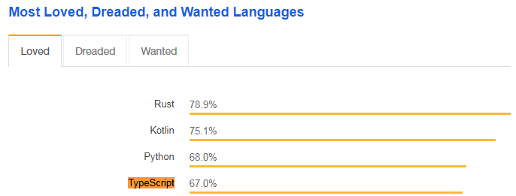
Popularity
2017

Slide 10








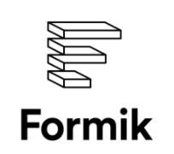
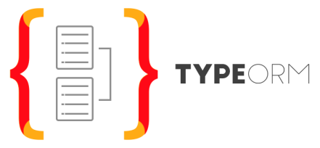

Things done using Typescript…
Apollo server & client
rxjs
grafana

Slide 11
Why?
Discover errors earlier
Autodocumented code
Refactor working like charm
You can do SOLID
You can do dependency injection
You can use decorators
You can have an AoP mindset

Slide 12
Why?
Demo Time!!!

Slide 13

Nestjs

Slide 14
Nestjs - Overview
Dependency Injection
Controllers
Components
Modules
Middlewares
Exception Filters
Pipes (Transformation and Validation)
Guards
Interceptors
Async/await ready ☺
Test Utils (Unit Testing + E2E)
Integration with TypeORM and Mongoose
Authentication with Passport (Strategy pattern)
GraphQL
Websockets
Microservices (Communication using sockets or REDIS)
CQRS
Swagger
RxJs + Observables + Streams

